Slide 1

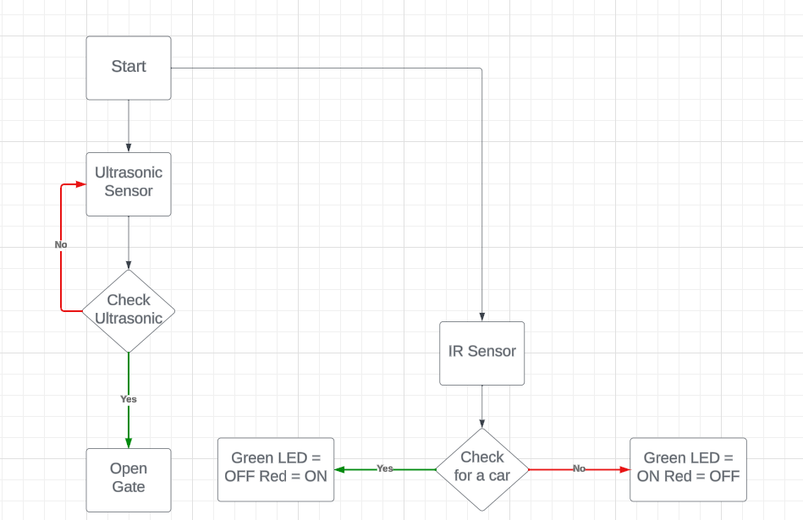
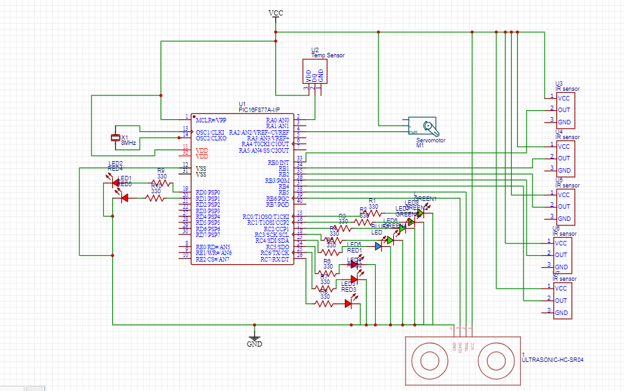
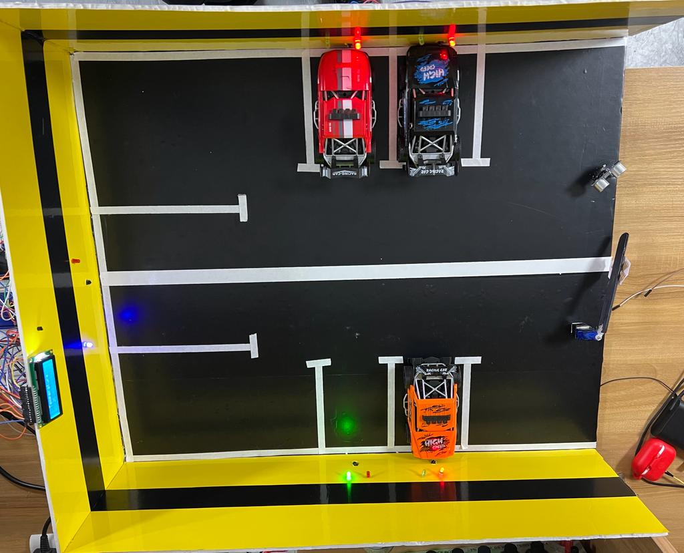
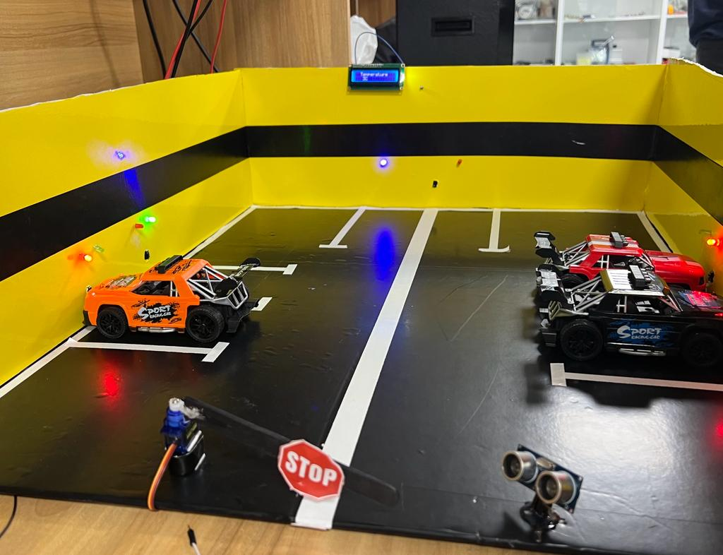
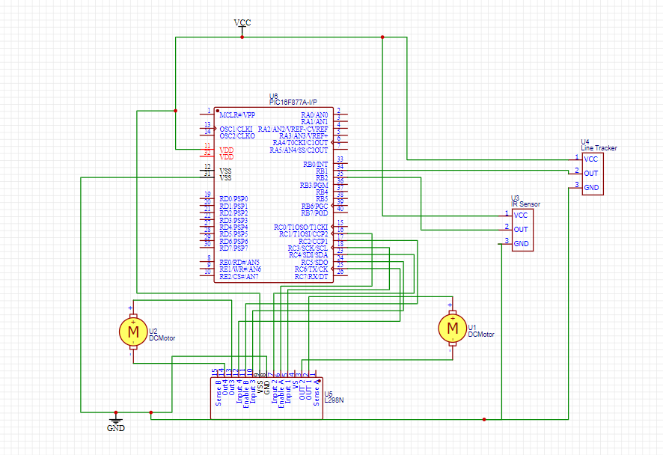
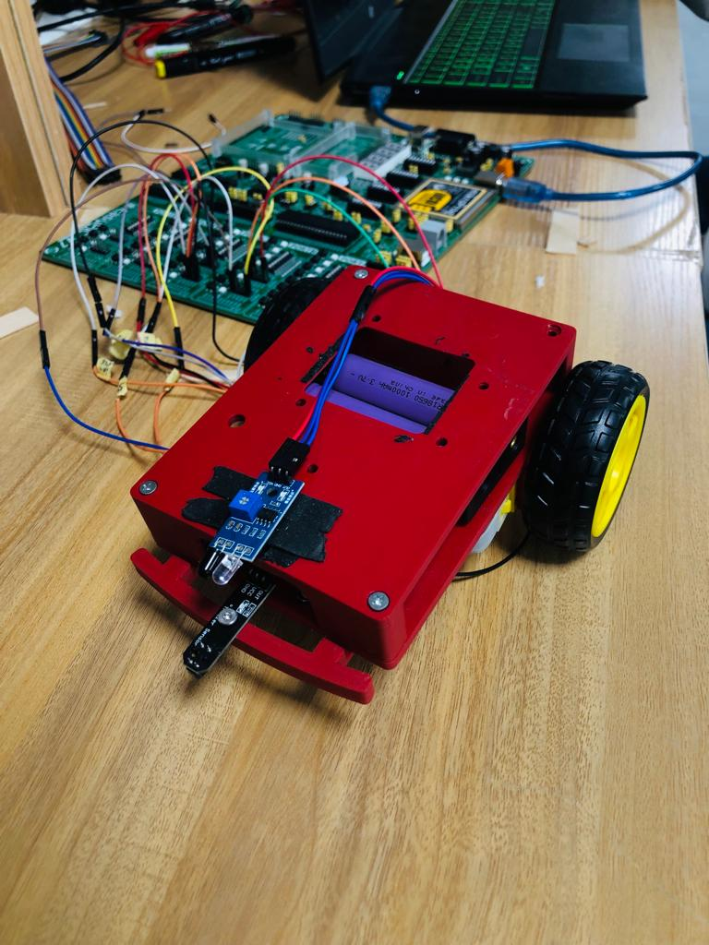
Smart Parking Space
Z. Hamzeh, A. Khawaja, and M. Anis
Supervisor: Dr. Anastassia Gharib
Embedded Systems Final Design Project, Fall 2023
King Abdullah II School of Engineering
Princess Sumaya University for Technology
Introduction
The Smart Parking Space project introduces a heightened level of intelligence to parking lots, enhancing convenience and efficiency. Utilizing advanced technologies such as infrared (IR) sensors, ultrasonic sensors, LEDs, LCDs, and servo motors, the system operates seamlessly. When a vehicle approaches, the ultrasonic sensor detects it and opens the gate smoothly using a motor. Within the parking space, IR sensors determine if a car is present, and green and red lights indicate space availability. The focus is not just on simplifying the user experience but also on leveraging technology to optimize parking and contribute to the sustainability of our cities.
Results
Figure 3: System Software Design
Figure 4: Parking top view
Figure 5: Parking entrance view
Figure 6: Smart Car
Design
.
Figure 1: Parking Hardware Design
Figure 2: Car Hardware Design
Conclusion
In summary, the Smart Parking Space project represents a leap forward in parking solutions, prioritizing user convenience and environmental sustainability. By incorporating cutting-edge technologies like infrared sensors, ultrasonic sensors, LEDs, LCDs, and servo motors, the system ensures a hassle-free parking experience. The key benefits lie in reducing search times for parking with real-time indicators, enhancing urban mobility, and contributing to environmental conservation by optimizing parking resource utilization. Our vision is to create not just smart parking spaces but also contribute to the development of smarter, greener cities for a better quality of life.

